Slide 1
Lecture 22
Elections
April 15, 2017

Slide 2
I. Why Bother Voting?

Slide 3
I. Voting & Apathy
WHY DO PEOPLE BOTHER TO VOTE?
The problem:
In a large election, one vote never makes a difference.
There are some costs attached to voting: getting information about candidates and parties, voter registration procedures, getting to the polls, waiting in line.
Since there is zero chance that there is any benefit from your individual act of voting (since one vote never decides an election), and since there are real costs to voting, why bother voting?
But if most people think this way, few people vote and democracy is weakened. Another prisoner’s dilemma!

Slide 4
I. Voting & Apathy
WHY DO PEOPLE BOTHER TO VOTE?
The problem:
In a large election, one vote never makes a difference.
There are some costs attached to voting: getting information about candidates and parties, voter registration procedures, getting to the polls, waiting in line.
Since there is zero chance that there is any benefit from your individual act of voting (since one vote never decides an election), and since there are real costs to voting, why bother voting?
But if most people think this way, few people vote and democracy is weakened. Another prisoner’s dilemma!

Slide 5
I. Voting & Apathy
WHY DO PEOPLE BOTHER TO VOTE?
The problem:
In a large election, one vote never makes a difference.
There are some costs attached to voting: getting information about candidates and parties, voter registration procedures, getting to the polls, waiting in line.
Since there is zero chance that there is any benefit from your individual act of voting (since one vote never decides an election), and since there are real costs to voting, why bother voting?
But if most people think this way, few people vote and democracy is weakened. Another prisoner’s dilemma!

Slide 6
I. Voting & Apathy
WHY DO PEOPLE BOTHER TO VOTE?
The problem:
In a large election, one vote never makes a difference.
There are some costs attached to voting: getting information about candidates and parties, voter registration procedures, getting to the polls, waiting in line.
Since there is zero chance that there is any benefit from your individual act of voting (since one vote never decides an election), and since there are real costs to voting, why bother voting?
But if most people think this way, few people vote and democracy is weakened. Another prisoner’s dilemma!

Slide 7
I. Voting & Apathy
So:
Why do people vote?

Slide 8
I. Voting & Apathy
Answer
It only makes sense to vote if you do not make the decision on the basis of simple cost-benefit calculation. People vote mainly because they see it as a civic obligation and they believe it is wrong to be a free rider on other people’s efforts.

Slide 9
I. Voting & Apathy
Answer
It only makes sense to vote if you do not make the decision entirely on the basis of a simple cost-benefit calculation. People vote mainly because they see it as a civic obligation and they believe it is wrong to be a free rider on other people’s efforts.

Slide 10
I. Voting & Apathy
Implication:
two key issues in explaining variations in voting
Variations in sense of civic obligation
Variations in the barriers and costs to voting

Slide 11
I. Voting & Apathy
Implication:
two key issues in explaining variations in voting
Variations in the barriers and costs to voting
Variations in sense of civic obligation

Slide 12
Average voter turnout in national elections for lower legislative house, 1945-2013

Slide 13
I. Voting & Apathy
Voter Turnout in U.S. National Elections, 1948-2016

Slide 14
I. Voting & Apathy
How U.S. social conditions and political institutions
undermine voting
Costs of voting: cumbersome registration rules; photo I.D. cards
Consumerism, individualism and privatism undermine value of collective institutions, including democracy.
Constant attack on the “affirmative state” undermines people’s identification with government and belief in politics
High levels of inequality erode the sense of community and the sense of civic obligation.
The role of money in politics makes many people feel cynical about participation: corruption breeds cynicism and cynicism breeds apathy

Slide 15
I. Voting & Apathy
How U.S. social conditions and political institutions
undermine voting
Costs of voting: cumbersome registration rules; photo I.D. cards
Consumerism, individualism and privatism undermine value of collective institutions, including democracy.
Constant attack on the “affirmative state” undermines people’s identification with government and belief in politics
High levels of inequality erode the sense of community and the sense of civic obligation.
The role of money in politics makes many people feel cynical about participation: corruption breeds cynicism and cynicism breeds apathy

Slide 16
I. Voting & Apathy
How U.S. social conditions and political institutions
undermine voting
Costs of voting: cumbersome registration rules; photo I.D. cards
Consumerism, individualism and privatism undermine value of collective institutions, including democracy.
Constant attack on the “affirmative state” undermines people’s identification with government and belief in politics
High levels of inequality erode the sense of community and the sense of civic obligation.
The role of money in politics makes many people feel cynical about participation: corruption breeds cynicism and cynicism breeds apathy

Slide 17
I. Voting & Apathy
How U.S. social conditions and political institutions
undermine voting
Costs of voting: cumbersome registration rules; photo I.D. cards
Consumerism, individualism and privatism undermine value of collective institutions, including democracy.
Constant attack on the “affirmative state” undermines people’s identification with government and belief in politics
High levels of inequality erode the sense of community and the sense of civic obligation.
The role of money in politics makes many people feel cynical about participation: corruption breeds cynicism and cynicism breeds apathy

Slide 18
I. Voting & Apathy
How U.S. social conditions and political institutions
undermine voting
Costs of voting: cumbersome registration rules; photo I.D. cards
Consumerism, individualism and privatism undermine value of collective institutions, including democracy.
Constant attack on the “affirmative state” undermines people’s identification with government and belief in politics
High levels of inequality erode the sense of community and the sense of civic obligation.
The role of money in politics makes many people feel cynical about participation: corruption breeds cynicism and cynicism breeds apathy

Slide 19
I. Voting & Apathy
How U.S. social conditions and political institutions
undermine voting
Costs of voting: cumbersome registration rules; photo I.D. cards
Consumerism, individualism and privatism undermine value of collective institutions, including democracy.
Constant attack on the “affirmative state” undermines people’s identification with government and belief in politics
High levels of inequality erode the sense of community and the sense of civic obligation.
The role of money in politics makes many people feel cynical about participation: corruption breeds cynicism and cynicism breeds apathy.

Slide 20
II. REPRESENTATION RULES

Slide 21
II. REPRESENTATION RULES
Key idea
Different electoral rules of the game generate very different dynamics of political competition with very different long term effects on democratic life.
Of particular importance = the rules of electoral competition and representation shape the number and strength of political parties.

Slide 22
II. REPRESENTATION RULES
2. Basic Structure of US system
Single member districts with plurality voting, also called “first past the post single member districts”: Whoever gets the most votes wins.
Example: Three candidates, one gets 34% of the vote, the other two each gets 32% of the vote. The first candidate is elected.
Consequence: two party duopoly because of fear of wasting vote on third parties.
This encourages “lesser of two evils voting”

Slide 23
II. REPRESENTATION RULES
3. Voting rules in the past in the US
“Fusion voting” in 19th Century US:
Basic idea: two parties could nominate the same candidate, so that candidate could appear o9n the ballot more than once, under different “party lines.” This increased the strength of third parties and their role in elections.
Most important case in the 19th century = The Populist Party
Still exists in a few places, like New York. New York has the strongest third parties in the nation.

Slide 24
II. REPRESENTATION RULES
4. Alternative voting rules that might increase the democraticness of elections
Proportional Representation [PR]: multi-member districts with each party running multiple candidates on a “party list”. Candidates are elected proportionately to the vote for the party.
Instant Run-off voting [IRV]: You rank-order the candidates on the ballot when you vote.
Proxy voter-representation: All candidates receiving above a threshold (e.g. 20% of votes) are elected; in the legislature representatives cast the number of votes they received in election. Second preference votes of excluded candidates are redistributed to elected candidates

Slide 25
II. REPRESENTATION RULES
4. Alternative voting rules that might increase the democraticness of elections
Proportional Representation [PR]: multi-member districts with each party running multiple candidates on a “party list”. Candidates are elected proportionately to the vote for the party.
Instant Run-off voting [IRV]: You rank-order the candidates on the ballot when you vote.
Proxy voter-representation: All candidates receiving above a threshold (e.g. 20% of votes) are elected; in the legislature representatives cast the number of votes they received in election. Second preference votes of excluded candidates are redistributed to elected candidates

Slide 26
II. REPRESENTATION RULES
Instant Run-off Elections: how it works
Candidates | 1st place votes | 2nd choices |  |  | Vote count after first round | Vote count after second round
 |  | A | B | C
A | 1700 | - | 1500 | 200 | 1700 = 28% | X
B | 2100 | 1500 | - | 600 | 2100 = 35% | 3600 = 60%
C | 2200 | 300 | 2000 | - | 2200 = 37% | 2400 = 40%

Slide 27
II. REPRESENTATION RULES
4. Alternative voting rules that might increase the democraticness of elections
Proportional Representation [PR]: multi-member districts with each party running multiple candidates on a “party list”. Candidates are elected proportionately to the vote for the party.
Instant Run-off voting [IRV]: You rank-order the candidates on the ballot when you vote.
Proxy voter-representation: All candidates receiving above a threshold (e.g. 20% of votes) are elected. Second preference votes of excluded candidates are redistributed to elected candidates. In the legislature, legislators cast the number of votes they received in election.

Slide 28
II. REPRESENTATION RULES
Proxy-voter representation: how it works
Candidates | votes | % of total votes | outcome | Redistributed second preference votes of voters for candidate D | Votes cast in representative in the legislature
A | 35,000 | 35% | elected | 0 | 35,000
B | 30,000 | 30% | elected | 12,000 | 42,000
C | 20,000 | 20% | elected | 3,000 | 23,000
D | 15,000 | 15% | Not elected | - | -

Slide 29
III. ELECTORAL DISTRICTS

Slide 30
III. ELECTORAL DISTRICTS
Hypothetical Example
of How District Boundaries can affect Electoral Outcomes
District Number | Votes for Democratic candidate | Votes for Republican candidate | Winner in election
1 | 2 million | 100,000 | Democrat
2 | 1 million | 1.1 million | Republican
3 | 1 million | 1.1 million | Republican
Total | 4 million | 2.3 million | 1 Democrat, 2 Republicans
 | 63.5% | 36.5% | 33.3% Democrats 66.3% Republicans

Slide 31
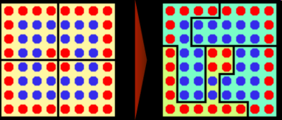
III. ELECTORAL DISTRICTS
Packing & Cracking
Redrawing the balanced electoral districts in this example creates a guaranteed 3-to-1 advantage in representation for the blue voters. Here, 14 red voters are packed into the lower left district and the remaining 18 are cracked across the 3 blue districts.
From Wikipedia

Slide 32
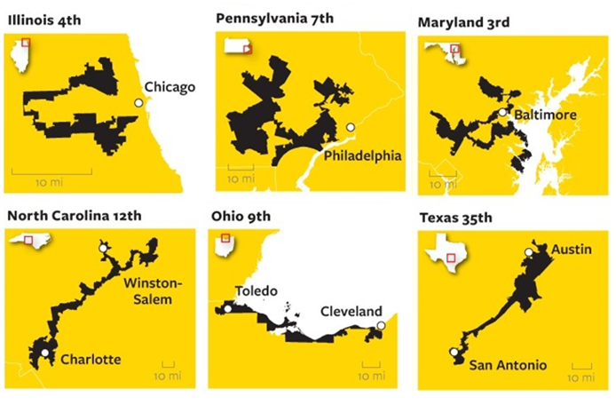
Examples of Gerrymandering after 2010 redistricting

Slide 33
Gerrymandering effects in the 2012 elections for
U.S. House of Representatives
 | Votes |  | Seats
 | Democrats | Republicans | Democrats | Republicans
U.S. House | 53,952,240 | 53,402,643 | 201 | 234
Wisconsin | 1,443,190 | 1,399,871 | 3 | 5
Pennsylvania | 2,702,901 | 2,627,031 | 5 | 13
One of worst cases: Pennsylvania
Margin of victory in Democratic Seats vs Republican Seats
Democrats won their districts by 52.6 % points on average
Republicans won their districts by 18.7% points on average

Slide 34
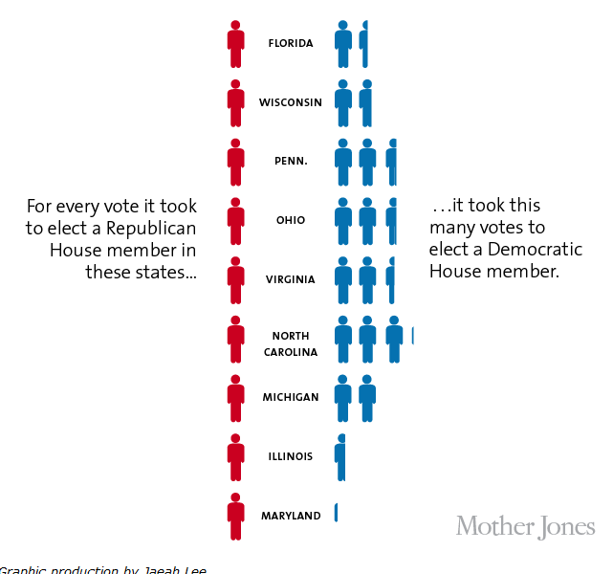

Slide 35
IV. MONEY AND POLITICS

Slide 36
IV. MONEY AND POLITICS
Two core problems
Lobbying:
Legislators have limited staffs to study problems, work out policies, acquire information. Well-funded lobbyists provide vast amounts of slick information to politicians and government officials
2. Campaign Finance
It costs an enormous amount to run for national public office, and almost always the candidate with the most money wins. Does this undermine equality of citizens in a democracy?

Slide 37
IV. MONEY AND POLITICS
Two core problems
Lobbying:
Legislators have limited staffs to study problems, work out policies, acquire information. Well-funded lobbyists provide vast amounts of slick information to politicians and government officials
2. Campaign Finance
It costs an enormous amount to run for national public office, and almost always the candidate with the most money wins. Does this undermine equality of citizens in a democracy?

Slide 38
IV. MONEY AND POLITICS
Two core problems
Lobbying:
Legislators have limited staffs to study problems, work out policies, acquire information. Well-funded lobbyists provide vast amounts of slick information to politicians and government officials
2. Campaign Finance
It costs an enormous amount to run for national public office, and almost always the candidate with the most money wins. Does this undermine equality of citizens in a democracy?

Slide 39
IV. MONEY AND POLITICS
Campaign Finance: the legal context
Two Supreme Court cases: Buckley v Valeo (1976 ) and Citizens United v Federal Elections Commission (2010)
Basic ruling declared that most restrictions on campaign spending amount to restrictions on free speech.
The Government cannot restrict:
Candidates spending from their own pockets
Overall level of spending
“Independent expenditures” on issue ads
Corporations spending on independent ads for candidates
Only real limits = on direct contributions to candidates (but there are ways to get around this).

Slide 40
IV. MONEY AND POLITICS
Campaign Finance: the legal context
Two Supreme Court cases: Buckley v Valeo (1976 ) and Citizens United v Federal Elections Commission (2010)
Basic ruling declared that most restrictions on campaign spending amount to restrictions on free speech.
The Government cannot restrict:
Candidates spending from their own pockets
Overall level of spending
“Independent expenditures” on issue ads
Corporations spending on independent ads for candidates
Only real limits = on direct contributions to candidates (but there are ways to get around this).

Slide 41
IV. MONEY AND POLITICS
Consequences:
Candidates without strong financial networks or personal fortunes cannot run for office: the Senate is filled with millionaires.
Candidates get the vast portion of their money from wealthy individuals and corporations: in 2008 only 1% of adult population contributed $200 or more to political campaigns.
There is a strong correlation of the votes of politicians and their sources of funding. Example: The 213 members of congress who voted to spend almost half a billion more on B-2 stealth bombers received on average $2100 from the contractor; the 210 who voted against only got $100. [Note: this does not prove quid-pro-quo]

Slide 42
IV. MONEY AND POLITICS
Consequences:
Candidates without strong financial networks or personal fortunes cannot run for office: the Senate is filled with millionaires.
Candidates get the vast portion of their money from wealthy individuals and corporations: in 2008 only 1% of adult population contributed $200 or more to political campaigns.
There is a strong correlation of the votes of politicians and their sources of funding. Example: The 213 members of congress who voted to spend almost half a billion more on B-2 stealth bombers received on average $2100 from the contractor; the 210 who voted against only got $100. [Note: this does not prove quid-pro-quo]

Slide 43
IV. MONEY AND POLITICS
Consequences:
Candidates without strong financial networks or personal fortunes cannot run for office: the Senate is filled with millionaires.
Candidates get the vast portion of their money from wealthy individuals and corporations: in 2008 only 1% of adult population contributed $200 or more to political campaigns.
There is a strong correlation of the votes of politicians and their sources of funding. Example: The 213 members of congress who voted to spend almost half a billion more on B-2 stealth bombers received on average $2100 from the contractor; the 210 who voted against only got $100. [Note: this does not prove quid-pro-quo]

Slide 44
IV. MONEY AND POLITICS
Campaign Finance: solutions?
(1) The Patchwork Option
(2) Direct public funding of campaigns
(3) The “Democracy Card”
(4) A more radical solution: Replace one elected chamber with a randomized citizen assembly

Slide 45
IV. MONEY AND POLITICS
Campaign Finance solutions
(1) The Patchwork Option – keep adding targeted restrictions and provisions. The McCain-Feingold campaign finance reform was an example. Citizens United undermined this solution.

Slide 46
IV. MONEY AND POLITICS
Campaign Finance solutions
(2) Direct Public Funding: The “Clean Elections Act”
Candidates who participate agree to accept only public funding
To qualify, need a specified number of $5 contributions
Special provisions for “start-up funds”
No matching funds: all candidates get the same
Clean Election candidates get more money if outspent by privately funded candidates

Slide 47
IV. MONEY AND POLITICS
(3) The Democracy Card
Every registered voter gets (for example) a $50 political credit card when they register to vote.
This card can be used to make contributions to any political candidate or political organization.
With 130 million registered voters, this comes to a maximum of $6.5 billion dollars per year for all elections
If a candidate gets any private contributions they cannot use any democracy money.
There is no limit to how much money a candidate can get through democracy card donations.
Allocating democracy card money is therefore itself an egalitarian political act – candidates first campaign for democracy dollars and then for votes, but both are based on equality of citizens.

Slide 48
IV. MONEY AND POLITICS
(3) The Democracy Card
Every registered voter gets (for example) a $50 political credit card when they register to vote.
This card can be used to make contributions to any political candidate or political organization.
With 130 million registered voters, this comes to a maximum of $6.5 billion dollars per year for all elections
If a candidate gets any private contributions they cannot use any democracy money.
There is no limit to how much money a candidate can get through democracy card donations.
Allocating democracy card money is therefore itself an egalitarian political act – candidates first campaign for democracy dollars and then for votes, but both are based on equality of citizens.

Slide 49
IV. MONEY AND POLITICS
(3) The Democracy Card
Every registered voter gets (for example) a $50 political credit card when they register to vote.
This card can be used to make contributions to any political candidate or political organization.
With 130 million registered voters, this comes to a maximum of $6.5 billion dollars per year for all elections
If a candidate gets any private contributions they cannot use any democracy money.
There is no limit to how much money a candidate can get through democracy card donations.
Allocating democracy card money is therefore itself an egalitarian political act – candidates first campaign for democracy dollars and then for votes, but both are based on equality of citizens.

Slide 50
IV. MONEY AND POLITICS
(3) The Democracy Card
Every registered voter gets (for example) a $50 political credit card when they register to vote.
This card can be used to make contributions to any political candidate or political organization.
With 130 million registered voters, this comes to a maximum of $6.5 billion dollars per year for all elections
If a candidate gets any private contributions they cannot use any democracy money.
There is no limit to how much money a candidate can get through democracy card donations.
Allocating democracy card money is therefore itself an egalitarian political act – candidates first campaign for democracy dollars and then for votes, but both are based on equality of citizens.

Slide 51
IV. MONEY AND POLITICS
(3) The Democracy Card
Every registered voter gets (for example) a $50 political credit card when they register to vote.
This card can be used to make contributions to any political candidate or political organization.
With 130 million registered voters, this comes to a maximum of $6.5 billion dollars per year for all elections
If a candidate gets any private contributions they cannot use any democracy money.
There is no limit to how much money a candidate can get through democracy card donations.
Allocating democracy card money is therefore itself an egalitarian political act – candidates first campaign for democracy dollars and then for votes, but both are based on equality of citizens.

Slide 52
IV. MONEY AND POLITICS
(3) The Democracy Card
Every registered voter gets (for example) a $50 political credit card when they register to vote.
This card can be used to make contributions to any political candidate or political organization.
With 130 million registered voters, this comes to a maximum of $6.5 billion dollars per year for all elections
If a candidate gets any private contributions they cannot use any democracy money.
There is no limit to how much money a candidate can get through democracy card donations.
Allocating democracy card money is therefore itself an egalitarian political act – candidates first campaign for democracy dollars and then for votes, but both are based on equality of citizens.

Slide 53
IV. MONEY AND POLITICS
(3) The Democracy Card
Every registered voter gets (for example) a $50 political credit card when they register to vote.
This card can be used to make contributions to any political candidate or political organization.
With 130 million registered voters, this comes to a maximum of $6.5 billion dollars per year for all elections
If a candidate gets any private contributions they cannot use any democracy money.
There is no limit to how much money a candidate can get through democracy card donations.
Allocating democracy card money is therefore itself an egalitarian political act – candidates first campaign for democracy dollars and then for votes, but both are based on equality of citizens.

Slide 54
IV. MONEY AND POLITICS
(4) A randomly-selected Citizens Assembly
Replace one elected legislative chamber with a chamber of randomly selected citizens (called a sortition legislature)
The sortition chamber has equal power to the elected chamber
Citizen legislators serve four years terms, with 25% being replaced each year
They are paid very well – e.g. twice the median income
Citizen legislators have a period of training and a strong professional support staff

Slide 55
IV. MONEY AND POLITICS
(4) A randomly-selected Citizens Assembly
Replace one elected legislative chamber with a chamber of randomly selected citizens (called a sortition legislature)
The sortition chamber has equal power to the elected chamber
Citizen legislators serve four years terms, with 25% being replaced each year
They are paid very well – e.g. twice the median income
Citizen legislators have a period of training and a strong professional support staff

Slide 56
IV. MONEY AND POLITICS
(4) A randomly-selected Citizens Assembly
Replace one elected legislative chamber with a chamber of randomly selected citizens (called a sortition legislature)
The sortition chamber has equal power to the elected chamber
Citizen legislators serve four years terms, with 25% being replaced each year
They are paid very well – e.g. twice the median income
Citizen legislators have a period of training and a strong professional support staff

Slide 57
IV. MONEY AND POLITICS
(4) A randomly-selected Citizens Assembly
Replace one elected legislative chamber with a chamber of randomly selected citizens (called a sortition legislature)
The sortition chamber has equal power to the elected chamber
Citizen legislators serve four years terms, with 25% being replaced each year
They are paid very well – e.g. twice the median income
Citizen legislators have a period of training and a strong professional support staff

Slide 58
IV. MONEY AND POLITICS
(4) A randomly-selected Citizens Assembly
Replace one elected legislative chamber with a chamber of randomly selected citizens (called a sortition legislature)
The sortition chamber has equal power to the elected chamber
Citizen legislators serve four years terms, with 25% being replaced each year
They are paid very well – e.g. twice the median income
Citizen legislators have a period of training and a strong professional support staff

Slide 59
IV. MONEY AND POLITICS
(4) A randomly-selected Citizens Assembly
Replace one elected legislative chamber with a chamber of randomly selected citizens (called a sortition legislature)
The sortition chamber has equal power to the elected chamber
Citizen legislators serve four years terms, with 25% being replaced each year
They are paid very well – e.g. twice the median income
Citizen legislators have a period of training and a strong professional support staff

